Slide 1

Retail Analytics Dashboard: Data-Driven Business Insights
Transforming complex retail data into actionable strategies for growth and optimization.
Total Revenue
Top Customer Value
Best-Selling Product
$5.2 Million
$12,500
Premium Smartwatch
Achieved this quarter across all channels.
Identified 'Elite Shopper' for personalized campaigns.
Analyzed sales to optimize inventory and promotions.

Slide 2
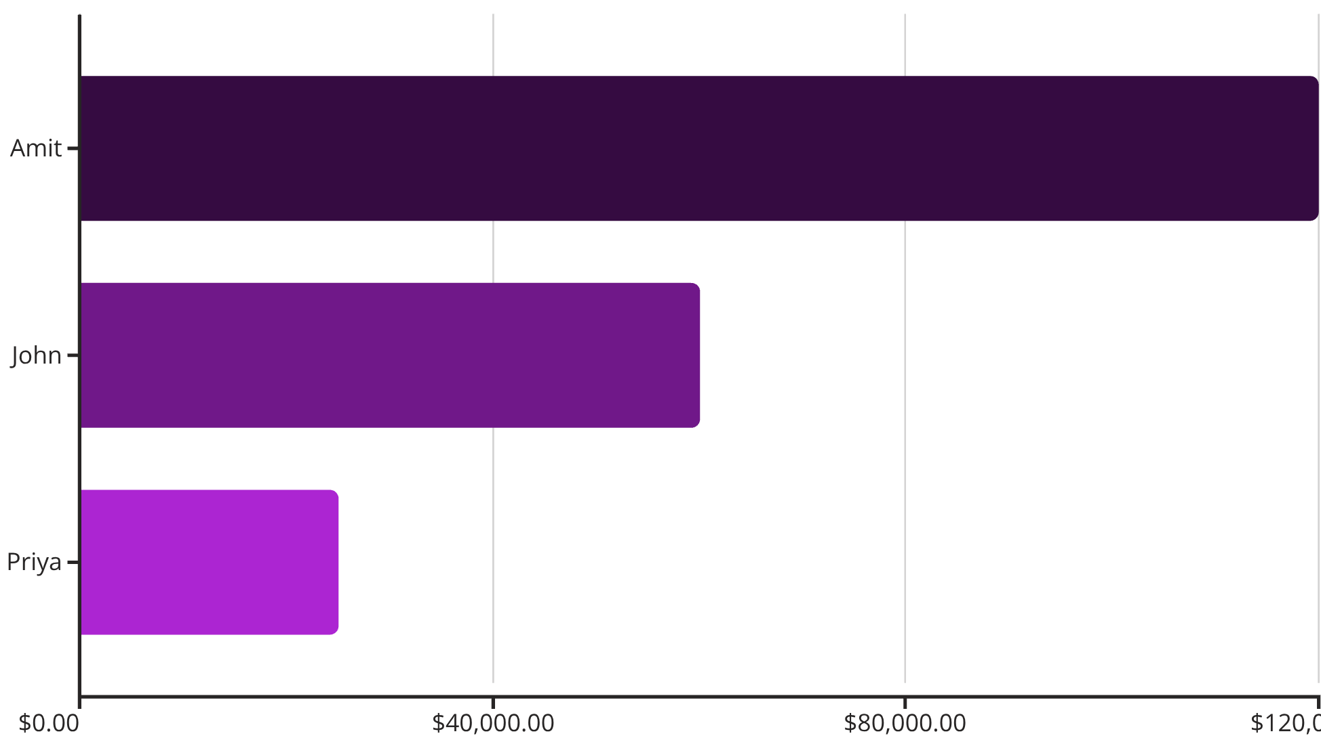

Customer Lifetime Value Analysis
Customer Performance
₹1.2L
CLV analysis:
Measures total customer monetary contribution.
Top Customer Value
Identifies high-value customers for retention.
Amit: Highest spender.
3
Active Customers
Total analyzed.
Key Insight: Amit is our top-value customer. Focus retention on top customers to maximize revenue.

Slide 3




Best-Selling Products
Smart TV
Laptop
2 units sold, quantity leader
1 unit sold, premium electronics
Mixer Grinder
Air Conditioner
1 unit sold, home appliance
1 unit sold, seasonal demand
Key Insights:
Smart TV is the best-selling product with 2 units.
Laptop, Mixer Grinder, and Air Conditioner each sold 1 unit.
These insights help optimize inventory and marketing efforts.

Slide 4
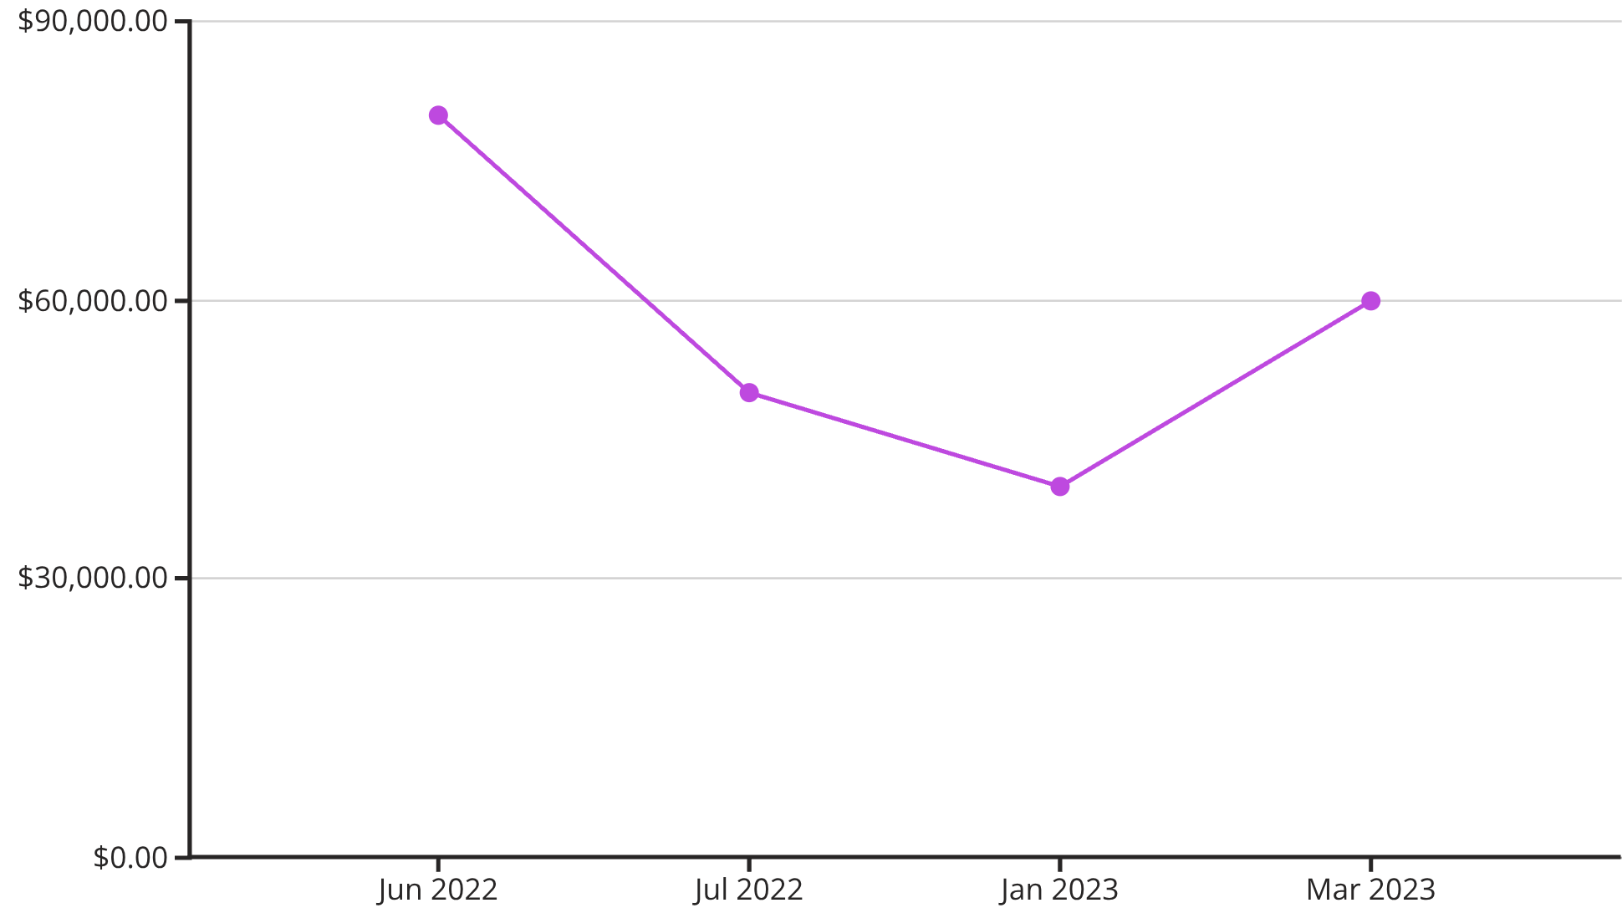

Monthly Sales Trend
Revenue Performance
Key for sales growth, seasonal trends, and inventory planning.
June 2022: Highest revenue ($80,000).
Strong performance: Jan and Mar 2023.
Moderate revenue: Jul 2022 ($50,000), Feb 2023 ($40,000).
Peak Performance: Revenue peaked in June 2022. Strong Q1 2023 recovery indicates seasonal patterns or effective campaigns.

Slide 5


Category-wise Revenue Distribution
97%
3%
Electronics
Home Appliances
₹1,75,000 total
₹5,000 total
Electronics Dominate
Strategic Implications
Electronics: ₹1,75,000 (97% of sales)
Leverage electronics expertise for growth.
Strong market position in consumer electronics.
Explore premium electronics lines.
Home Appliances: ₹5,000 (3% of sales)
Targeted marketing for home appliances.
Untapped opportunity for diversification.
Consider bundling strategies.

Slide 6




Inventory: No Stock Risk
Zero Stock Risk
No stock below 10 units
Healthy Inventory
Adequate stock levels
Current Status
Excellent inventory management: no products below critical 10-unit threshold. No immediate stock risk.
Optimal Levels
Proactive Monitoring
Future Focus
Ensures continuous availability.
Prevents stockouts; ensures satisfaction.
Monitor best-sellers to prevent risks.

Slide 7

Customer Retention
1
Repeat Customer
Only Amit
2
Total Orders
From Amit
Key Insight
Retention Opportunities
Value of Retention
Only 1 repeat customer (Amit) out of 3 total.
Implement loyalty programs.
Amit's 2 orders boost revenue.
33% repeat purchase rate is low.
Personalized email marketing & offers.
Nurturing existing customers is crucial for growth.
Significant opportunity to improve retention.
Post-purchase follow-ups.

Slide 8

Average Order Value (AOV)
₹46.2K
Average Order Value
Mean transaction size
Why AOV Matters
Strategic Uses
AOV (₹46,250) reveals typical transaction size.
Set free delivery thresholds.
Crucial for understanding customer spending.
Bundle offers around ₹46K.
Guides sales targets.
Target upsell opportunities.
High AOV suggests premium purchases and strong market position.
Benchmark industry performance.
Optimize customer acquisition cost.
Business Impact: AOV insights optimize marketing spend, refine promo strategies, and boost transaction values through smart bundling and cross-selling.

Slide 9



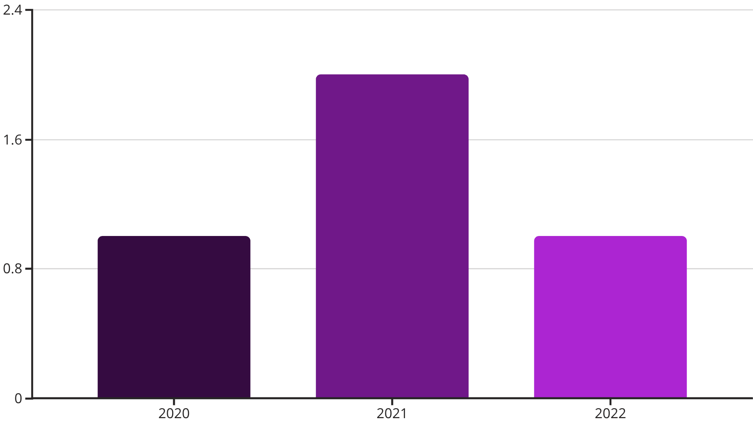
Regional Performance & Acquisition
Top Customers by Country
India
United States
United Kingdom
Top Customer: Amit
Top Customer: John
No Orders, Revenue: ₹0
Revenue: ₹1.2L
Revenue: ₹60K
Untapped market
Strongest performance
Second largest market
Acquisition Trend
Acquisition peaked in 2021 (2 new customers).
Steady acquisition, opportunity for targeted growth.
UK market is untapped: significant expansion opportunity.
Amit is top customer, leads India regionally.

Slide 10





Revenue Pareto: 80/20 Rule
Amit
Priya
₹1.2L (57.1%)
₹25K (89%)
1
2
3
John
₹60K (85.7%)
Pareto Confirmed
The analysis confirms the 80/20 Pareto principle:
Top 2 customers (~67% of base) drive ~86% revenue.
Amit alone contributes 57%.
86%
High-value customer retention is critical.
Top 2 Customers
Revenue validates Pareto
57%
Amit
Dominant revenue share
Strategic Outlook
Protect Key Customers
Grow Mid-Tier
Acquire Similar Profiles
VIP programs & dedicated account management
Elevate customers like Priya to higher spending
Target high-value customer characteristics

Slide 11
THANK YOU.

